Slide 1
1. Business Case
In Canada, around 58% of households report that they own at least a cat or a dog, and they are in a constant need to visit the Pet clinic for their pet’s health-checkup. Pet-owners, amidst their busy schedule, await a website that can assist them in addressing their pet’s well-being requirements.
Currently, pet-owners do not have any centralized repository to store their pet’s health statistics. Maintenance of these records would open a plethora of opportunities for business as we can automate certain processes that expedite an animal’s treatment.
These records can be shared globally, helping veterinarians around the world to diagnose diseases based on the similarity of symptoms found in the same breeds in another part of the world.

Slide 2
1. Business Case (cont’d)
Pet-owners are dependent on calls from the veterinary clinic to schedule timely appointments that match their routine and visit in person to get their pets examined. There is no provision to avail these services from home.
Even after scheduling an appointment, owners might forget to update their schedule and visit the clinic on time. This could play a big role in ensuring timely treatment for the animals.
Vets currently have to spend a lot of time submitting reports for the animals they examine. Automating the process with a built-in template will maximize the time-utilization and efficiency of the clinic.
In this situation, intelligent agents have a great potential in helping the owners get timely appointments and prevent deprivation of proper care and diagnosis for their pets.

Slide 3
2. System Description
The proposed E-Vet System(EVS) is a multi-agent system designed to render multiple functionalities to simplify the appointment booking process to the pet-owner(user) based on the owner’s preferences.
The clinic package is composed of a Video Interaction system, a Reminder generator, and a utility to generate medical reports.
The EVS application deals with a doctor’s multiple available schedules to find the optimum appointment window for the pet-owner, taking into consideration the related fees and severity of the symptoms.
The application has to schedule the appointment and send regular reminders for the appointment dates to the pet-owner. It also generates a medical report based upon the doctor’s feedback and stores it for future references.

Slide 4
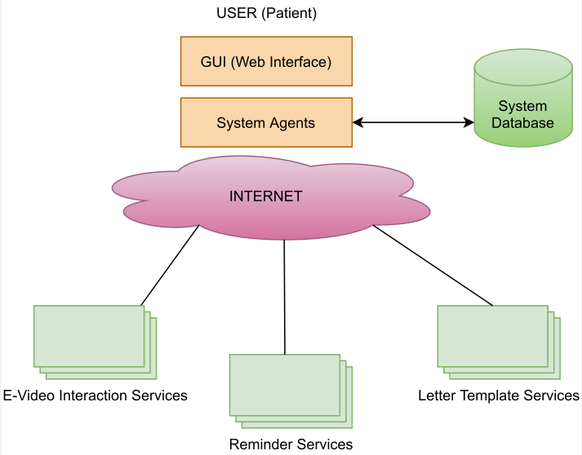
System Description (cont’d)

Slide 5
3. Assumptions
To enable video interaction between the doctor and the patient, the system will use existing video conferencing platforms (ZOOM/ Google Meet, etc.)
The user schedules their appointment using a web interface. The interface captures the user preferences and updates the available time slots in real time.

Slide 6
4. Requirements
The Video Enabled e-Vet System shall provide a web interface allowing the clients to login and register themselves.
It shall allow patients to schedule their appointments.
It shall record patient’s profile in a database and display it based on their name/id.
It shall remind patients of their appointments.
It shall send an appointment confirmation to the patient, including an invitation to the scheduled video enabled meeting
It shall provide multiple printable letter templates to doctors

Slide 7
5. Wish List (Not Implemented)
The e-vet system can send a recommendation letter to specialists on behalf of doctors.
The system should offer multiple payment options.
The system should have a mechanism to reply to instant scientific questions to physicians (similar to an encyclopedia).
The system can search in the ontology for relevant documents.
Doctors can also register themselves on the portal, giving the client freedom to choose their doctor(s).
Recording patient feedback on the doctor and doctor feedback on the patient.
E-pharmacy: customers can purchase medicines and other essentials through the portal and get them delivered to their homes.
Patients can complete a lab requisition through the portal.
Patients can communicate with the doctor via text messaging.
The system should display desired graphs and statistics based on a patient’s/doctor’s profile.

Slide 8
6. System Architecture
We have designed an Java web-application with interactive stand-alone interface for the customer to register and book appointments. There is a similar interface designed for Doctors to login and check their schedules.
The web-application communicates with the user through the interface, and stores the data persistently on a MySQL database. To seamlessly transfer the data from the UI to the database server, we have implemented MVC architecture.
The functionalities to send SMS messages for notifying successful appointment booking, we are using Restful APIs provided from Twilio. To generate the Zoom video link, we have utilized web-services through Soap/HTTP.
There are certain agents running on the backend, to facilitate the sending of E-mail notifications to the client in case of Appointment booking, cancellation and updates. Moreover, these agents also manage the auto-rescheduling of appointments in case there is an appointment already scheduled at the selected date/time. SMS notifications are sent in case of a successful appointment booking. In case of cancellation activities, the agent update the database and send a client an intimation mail.

Slide 9
System Architecture(contd.)
The client first registers as a user. In the registration screen, basic information such as client email, telephone, etc. is taken from the user and fed into the ‘client’ table. Upon successful registration, he will be able to login.
After login, the user creates an appointment by choosing the doctor, the suitable time and the pet details(breed, age, symptoms, etc.). He can then either reschedule the appointment or delete it.
Once an appointment is booked/updated/cancelled, respective SMSs are sent to the user for notification purpose. The doctor/patient also get an email message for confirmation. The online meeting details are sent in the notification.
The doctor logs in to check the appointments scheduled, and after diagnosing the patient the doctor will have to complete the appointment from the UI. Instantly, he will receive a mail asking for his feedback(managed through an agent). Once he submits the feedback, the agent will store the feedback in the ‘feedback’ table.
The Pdf Agent then filters the ‘feedback’ table and sends notification mails to the respective clients to provide them a link to download the report.

Slide 10
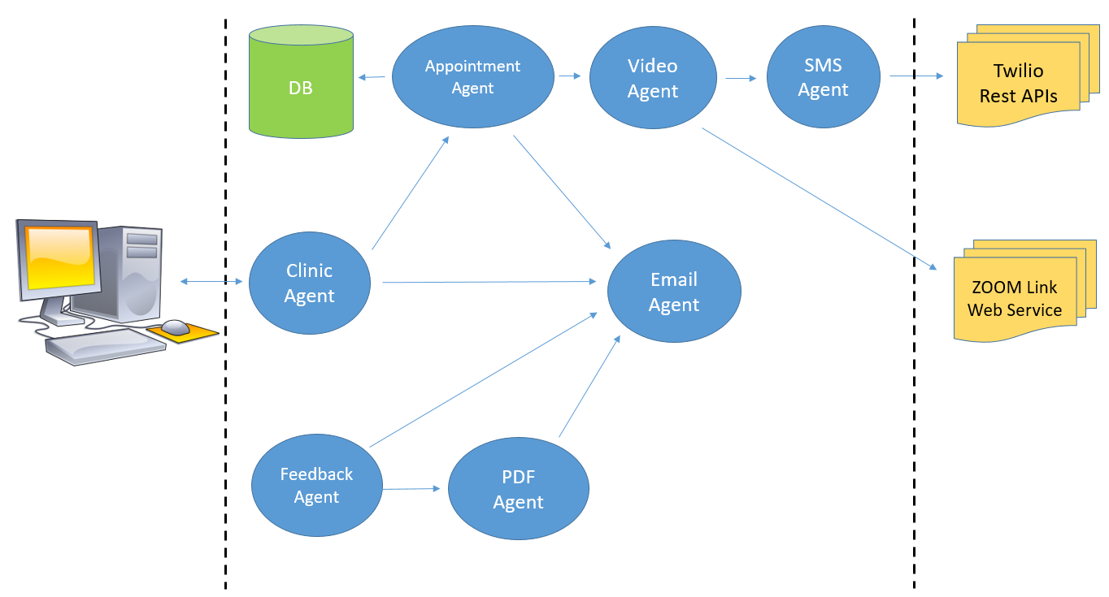
System Architecture(contd.)

Slide 11
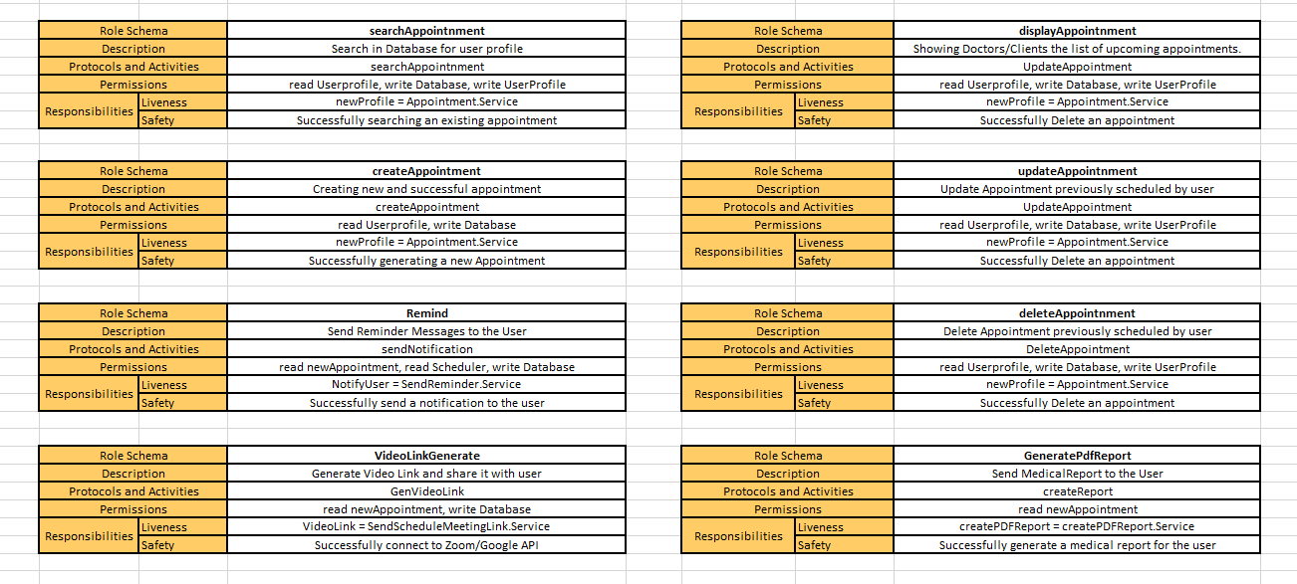
7. Role(Model) Identification

Slide 12
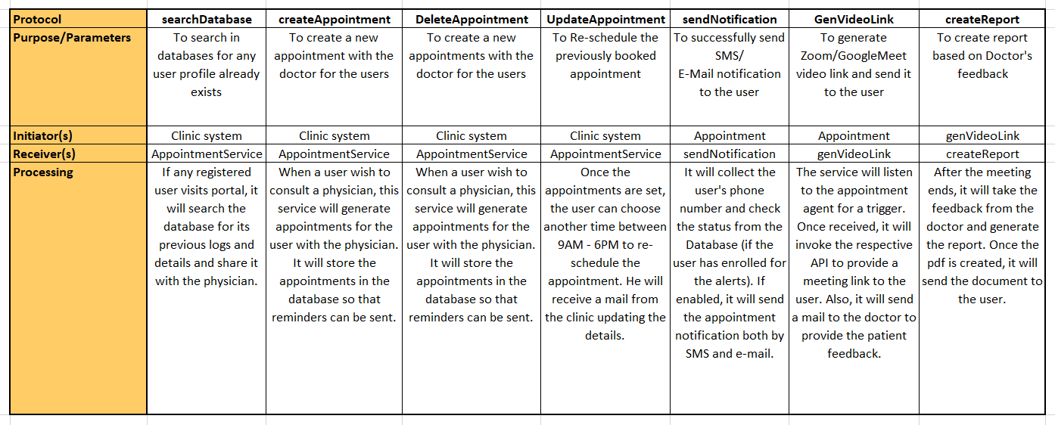
8. Interaction Diagram

Slide 13
9. Agent Description
Clinic System Agent
The clinic system agent accesses the request sent by the patient(user) through the web interface. In our Architecture the clinic system agent handles the correspondence with all the other agents(as a mediator) and in this way, which acts as a central hub.
The clinic system agent is the main agent which has access to the database of our system.
The clinic system agent requests appointments for the patients, search for the patient’s profile in database, shows the profile of patients to the doctor (if available!). Moreover, the clinic system agent also shows the profile of the doctor to the patients.
The clinic system agent also generates a request for the appointment agent to book an appointment whether it’s a first or a consecutive appointment. It also helps to update and cancel an appointment.
The clinic system agent also triggers the Notification agent to remind the patient about the appointments at some given times.
The clinic system agent also requests template(PDF) agent to generate the required template once the physician had completed the session with the patient.

Slide 14
Agent Description (cont’d)
Appointment Agent
The appointment agent communicates with the clinic system agent to book an appointment for the patient. The clinic agent system searches the database and give the required details regarding the available slots to the appointment agent.
The appointment agent can be a new appointment for those patients who registers for the first time.
Not only for the first time, but the appointment agent will also book appointments for the patients who visits again.
The appointment agent will also interact with the notification agent to signal the sending of SMS and Email notifying the pet-owner.
This agent communicates with the video agent to share a video link for use during the online consultation.
The agent will initiate call to the PDF Agent to create a report based on the Doctor’s diagnosis.

Slide 15
Agent Description (cont’d)
Reminder(SMS + Email) Agent
The Notification Agent communicates with the Clinic Agent at the time of booking an appointment, the Reminder Agent would be sending automated SMS messages and E-mail notifications to the user on his/her registered e-mail account and mobile number.
Instead of a receptionist logging in every time to trigger a reminder, the Agent by itself sends the message at regular intervals as chosen by the user.
In case the appointment is cancelled or updated, the Reminder Agent also intelligently updates the text message and sends an updated notification to the user.
Once the appointment is complete, the Reminder Agent directly accesses the database to update the alerting mechanism for that particular appointment.
In order to check if the registered email/phone number is valid, the Reminder Agent will trigger an acknowledgement message at the time of booking the appointment. Subsequently, the other reminder messages will be forwarded in due course.
The Agent also triggers a notification once the report has been generated, based upon the feedback from the veterinarian. In this case, it will await signal from the Template Agent.

Slide 16
Agent Description (cont’d)
Feedback(+PDF) Agent
The Template Agent provides the doctor with letter reports. Depending upon the video interaction between the doctor and the patient, the doctor can select and use the in-built template to document their diagnosis.
The Template Agent communicates with the Clinic System Agent after the video interaction between the client and doctor is complete.
If the Template Agent receives a request from the Clinic System Agent, the doctor is requested to input their feedback through mail.
A medical report is generated based on the doctor’s feedback and sent to the Clinic System Agent, which presents it to the user.

Slide 17
Agent Description (cont’d)
Video link Agent
The video link agent is responsible to generate a video link at the time of the appointment of the patient and send it to the registered email id as well as the registered mobile number of the patient.
The video agent directly communicates with the clinic system agent and creates the links according to the time slots selected by the patients.
To facilitate the video-based interaction between the doctor and patient, the system will use existing video conferencing platforms (ZOOM, Google Meet, etc.)
Patients will be able to join the meeting at their scheduled appointment time and the link will expire in 60 minutes which is the maximum time for consultation.
If the consultation needs more time than 60 minutes, then the patient will have to make another appointment with the clinic in order to continue it.

Slide 18
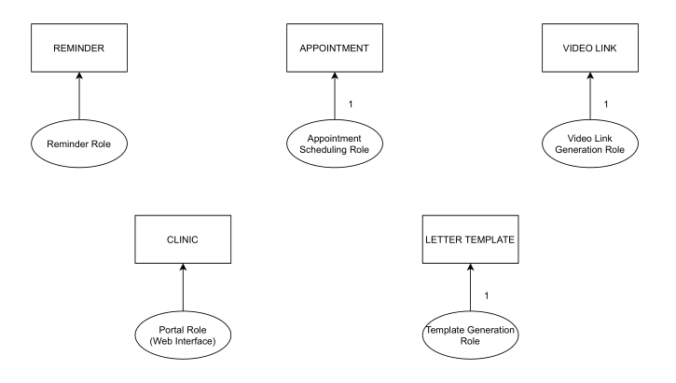
10. Design: Agent Model

Slide 19
11. Design: Service Model
Service | Input | Output | Pre – Conditions | Post Conditions
E-Video Interaction | Appointment Schedule | Link for Video Interaction | Successful connection to ZOOM/GOOGLE API | Steady connection during the meeting
Reminder | Appointment Schedule | Notifications | User email-id and mobile number required
Template | Doctor’s Feedback | Report in a PDF format | Successful completion of video interaction

Slide 20
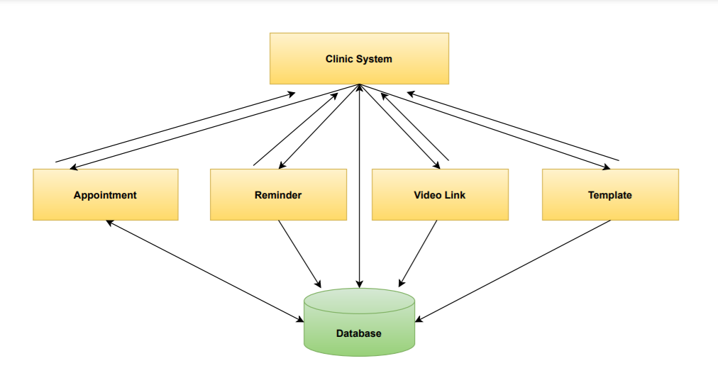
12. Design: Acquaintance Model

Slide 21
13. Agent Internal Architecture
Clinic User
Listener
Interpreter
Rest API/
Web Svc.
Processor
Discovery
Agent
Agent Boundary

Slide 22
Agent Internal Architecture(contd.)
Listener:
The Listener component listens to a port for any incoming Agent requests from the E-Vet Clinic application.
Interpreter
The Interpreter parses and interprets the incoming Appointment class Objects. We assume that all agents have agreed on a Document Type Definition (DTD).
Processor:
The Processor receives an Object as an input. It uses the Interpreter to parse the document, and calls the appropriate function to run a process. It looks up the agent from the Directory Facilitator(DF).
Discovery Agent:
The Discovery Agent provides the service discovery base-service (a superset of UDDI).

Slide 23
14. Technology Overview
Twilio SMS Services :-
Logical Information
Every client need to be reminded about the appointment on SMS so that the appointment is not missed. Twilio SMS services helps us in providing the SMS reminder service to the client.
Technical Information
Twilio is a large-scale customer engagement platform used for SMS and other services through its APIs. It has imported in our code by using twilio package and rest API with v2010. It is initialized by the account_SID and AUTH_TOKEN. We must always make sure that the country code is added correctly for the twilio number to send SMS.

Slide 24
Technology Overview(contd.)
Video Link Agent :-
Logical Information
The video link agent will generate a video link for the consultation and will send it to the registered mobile number at the time of the appointment. With this the client will be able to connect with the doctor for the stipulated time.
Technical Information
We have created a client and a server stub and written a code for the connection service using JDPC which connects to the SQL database . Zoom links table stores the meeting id,password and url for every combination of username and surname provided. Connection is happening through soap on XML. Inputs are username and surname and output is a list of zoom links pertaining to the input provided. The db contains list of all urls and the server queries the inputs and returns a list of all the urls that pertain to the username and surname provided

Slide 25
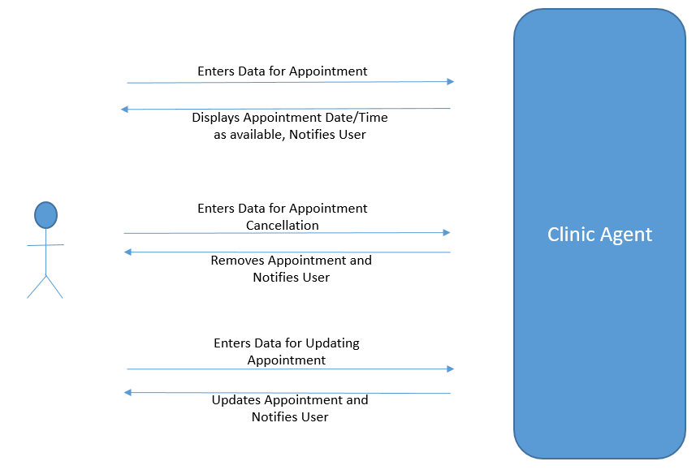
15. Use Cases : Clinic Agent

Slide 26
Use Case Definition : Clinic Agent
Brief Description: | The Actor uses this Use case to Request and Manage Clinic Appointments
Precondition(s): | Successful Login for the User is necessary post registration
Post Condition(s): | Considering all Services work as expected, the actor can manage creation, Update and Deletion of appointments
Process Steps
1 | Actor logs in into the Clinic Portal by entering his/her username and password.
2 | Actor Selects the option to create an appointment for a future date, and enters the relevant details (name, age, breed, criticality, etc.).
3 | Clinic Agent receives the request and sends information to the Appointment Agent to book the slot.
4 | Appointment Agent looks in the Database for available slots, and considers the nature of visit.
5 | Once Appointment slot is fixed, it retrieves the Zoom video link for sharing with user through the VideoLink Agent and Notification Agent.
6 | Clinic Agent then sends notification to the user about confirmation of appointment.
7 | Actor can choose to update appointment and send a new time as per her/her choice. Clinic Agent calls the Database and removes the appointment booking and makes slot available.
8 | For Updating of appointment, the slot in the Database is updated as per availability by the Clinic Agent.
9 | In both Steps 8 and 9 … Corresponding confirmation Notifications are sent to the user over email and SMS.

Slide 27
Use Case Definition : Clinic Agent
Exceptions
1a | System Not Accessible at this point |  | Error Message is generated stating that stystem is not accessible.
3a | I/O exceptions |  | Error Message is generated stating that input output functions is not reachable.
6b | Unreadable and SQL Exception |  | Error Message is generated when the agent is unable to send sms or any SQL database error.
Relationships:
Initiating | Actor
Collaborating | Notification Agent, Appointment agent
Other Diagrams:
Data Requirements
Data Required : | Data Required for Notification Agent
 | Pet information
 | Appointment preferences
 | Client information

Slide 28
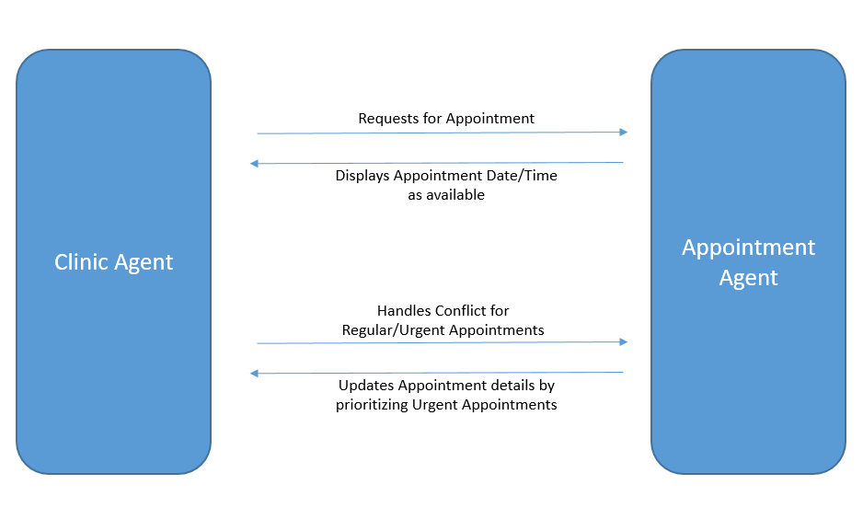
Use Cases(contd.) : Appointment Agent

Slide 29
Use Case Definition : Appointment Agent
Brief Description: | The Clinic System uses this Use case to schedule appointment for the user
Precondition(s): | User is registered and has requested for an appointment
Post Condition(s): | Considering all Services work as expected, the appointment agent can display, update, and prioritize appointments
Process Steps
1 | The Appointment agent receives relevant user information from the clinic system agent
2 | The Appointment Agent looks in the database for available slots and considers the nature of visit to allot a time slot to the user.
3 | Information about the allotted time slot of the user is sent to the clinic system agent to display it to the user.
4 | The appointment system agent updates the appointment details by in a case when an appointment is cancelled or needs to be prioritized.

Slide 30
Use Case Definition : Appointment Agent
Exceptions
1a | System Not Accessible at this point | Error Message is generated stating that system is not accessible.
3a | System cannot book an appointment | Error Message is generated stating that appointment slots are not available.
6b | Unreadable and SQL Exception | Error Message is generated when the agent is unable to send SMS or any SQL database error.
Relationships:
Initiating | Clinic System Agent
Collaborating | Notification Agent, Clinic System Agent
Other Diagrams:
Data Requirements
Data Required : | Data Required for Notification Agent
 | Pet information
 | Appointment preferences
 | Client information

Slide 31
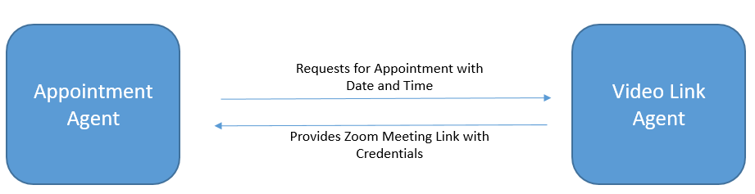
Use Cases (contd.) : Video Link Agent

Slide 32
Use Case Definition : Video Link Agent
Brief Description: | The Clinic System uses this Use case to generate a link for the user to have a video call with the doctor.
Precondition(s): | User is registered and appointment is already booked.
Post Condition(s): | Considering all Services work as expected, the video link agent will generate a link and send it to the user.
Process Steps
1 | The Video link agent receives relevant user information from the clinic system agent.
2 | The Video link agent also receives relevant information regarding the appointment details which the Appointment Agent has sent to the clinic system agent.
3 | The Video link agent will connect with the existing Video calling sites like Zoom, Google Meet, Teams etc. and will generate a link.
4 | The generated link by the Video link agent will be sent to the clinic System agent, which in turn will be sent to the user so that he can join the appointment with the doctor. There will be stipulated time for the video call.

Slide 33
Use Case Definition : Video Link Agent
Exceptions
1a | System Not Accessible at this point | Error Message is generated stating that system is not accessible.
4a | User is not able to access the link Or link Broken | Error Message is generated stating that user is unable to access or Link Broken.
6a
Relationships:
Initiating | Clinic System Agent
Collaborating | Appointment Agent, Clinic System Agent
Other Diagrams:
Data Requirements
Data Required : | Data Required for Video Link Agent
 | Booked Appointment Details
 | Email Address and Cell Phone Number of the user

Slide 34
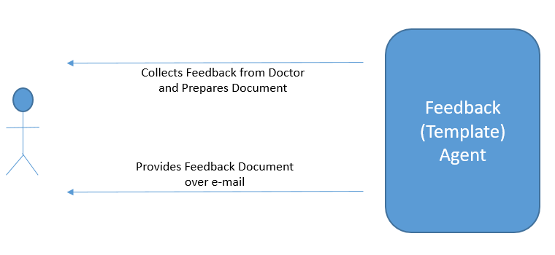
Use Cases (contd.) : PDF(Template) Agent

Slide 35
Use Case Definition : Template Agent
Brief Description: | The Template agent uses this Use case to generate a template for the doctor.
Precondition(s): | User has already consulted the doctor.
Post Condition(s): | Considering all Services work as expected, the template agent will generate a pre defined template for the doctor to store a report about the user’s diagnosis.
Process Steps
1 | The Template agent receives relevant user information from the clinic system agent
2 | The Template Agent will be woken up as soon as the doctor’s consultation with the user ends.
3 | The Doctor will request or select a specific type of template and will make the notes on the template regarding the diagnosis or the general discussion with the user.
4 | The template generated after Step 3 would be sent to the clinic system agent to store in the database and would also be sent to the user for future use.

Slide 36
Use Case Definition : Template(PDF) Agent
Exceptions
1a | System Not Accessible at this point | Error Message is generated stating that system is not accessible.
5a | Not able to generate Template or Missing fields. | Error message is generated regarding missing field of the template and not able to generate template
6a | SQL Exceptions | Error message will be generated with the SQL exception.
Relationships:
Initiating | Clinic System Agent
Collaborating | Video link agent, Clinic System Agent, Appointment agent
Other Diagrams:
Data Requirements
Data Required : | Data Required for Template Agent
 | Booked Appointment details
 | Email Address and Cell Phone Number of the user

Slide 37
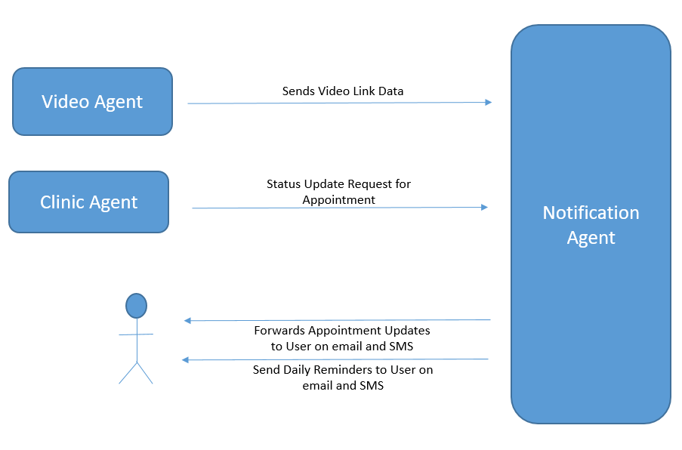
Use Cases (contd.) : Notification Agent

Slide 38
Use Case Definition : Notification Agent
Brief Description: | The Clinic System Agent uses this use case to send notifications to the user
Precondition(s): | Appointment is booked and a video link has been generated
Post Condition(s): | Considering all Services work as expected, the notification agent sends appointment updates to user via email and/or SMS
Process Steps
1 | The notification agent receives user information (email-address and cell phone number) from the clinic system agent
2 | The notification agent also receives video link information from the video agent
3 | The notification agent receives status update request from the clinic system agent at regular intervals
4 | The notification agent sends out notification to the user in form of updates and daily remainders

Slide 39
Use Case Definition : Notification Agent
Exceptions
1a | System Not Accessible at this point | Error Message is generated stating that system is not accessible.
3a | User not reachable at this point | Error Message is generated stating that user is not reachable.
6b | Unreadable and SQL Exception | Error Message is generated when the agent is unable to send SMS or any SQL database error.
Relationships:
Initiating | Clinic System Agent
Collaborating | Video Link Agent, Clinic System Agent
Other Diagrams:
Data Requirements
Data Required : | Data Required for Notification Agent
 | Video Link
 | Email Address and Cell Phone Number of the user
 | Booked Appointment details

Slide 40
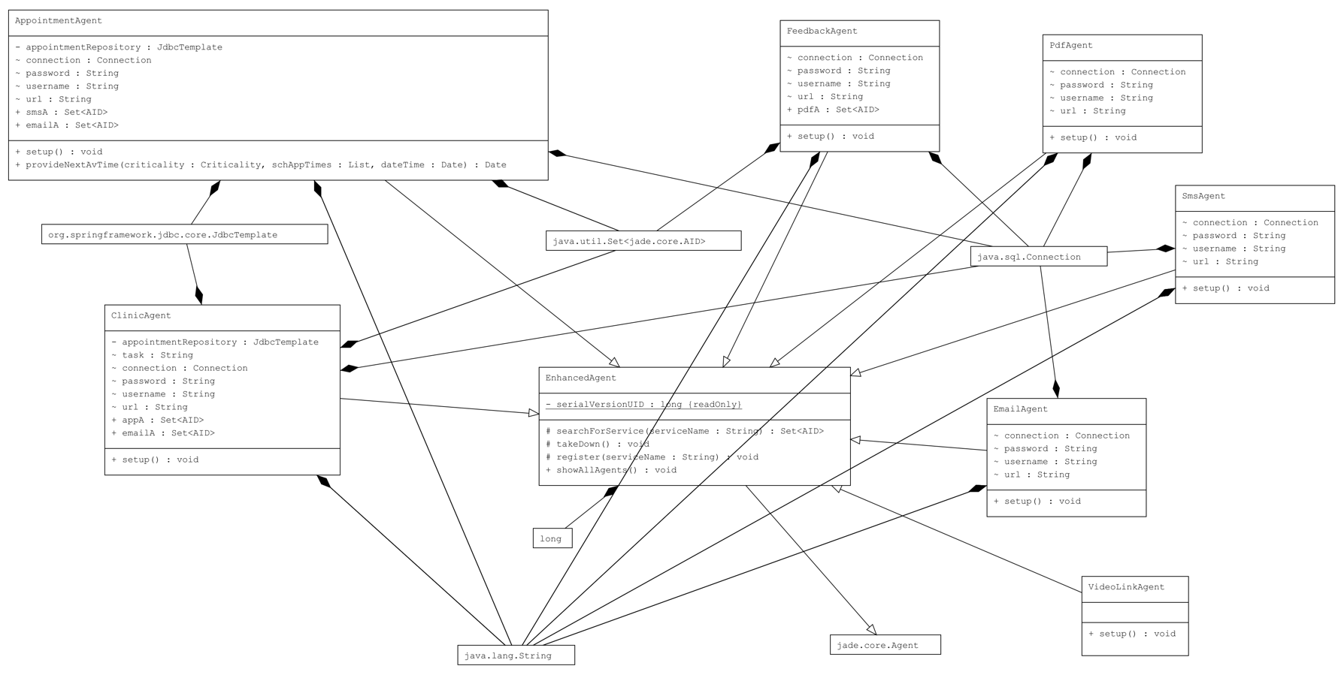
16. Class Diagram : Agents

Slide 41
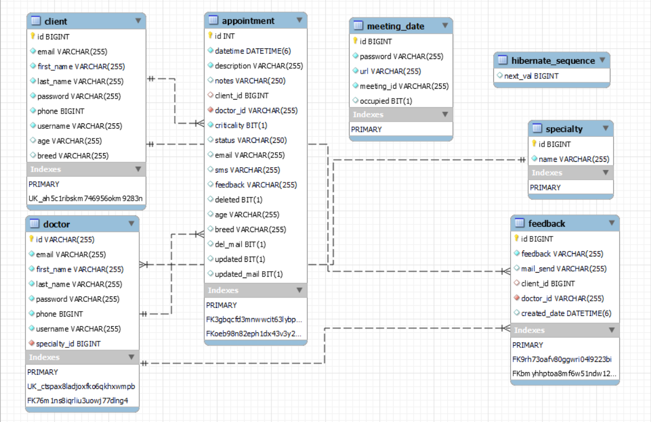
17. Data Specification : E-R Diagram

Slide 42
18. Typical Data Definition
Appointment: The appointment details(including Pet’s Symptoms and other client details) are stored in this table. This table also contains the appointment specific information such as criticality and feedback details. The table is used to keep track of the owner’s email, phone number and appointment status as well.
Field | Description | Type
id | Appointment ID | INT
datetime | Schedule of Appointment | DATETIME(6)
description | Pet’s Description | VARCHAR(255)
notes | Additional Notes | VARCHAR(250)
client_id | Pet Owner’s identification # | BIGINT
doctor_id | Doctor’s identification # | VARCHAR(255)
criticality | If appointment is ‘URGENT’ or ‘REGULAR’ | VARCHAR(10)
status | Flag to check if appointment is booked | VARCHAR(250)
email | Owner’s email | VARCHAR(255)
sms | Owner’s sms | VARCHAR(255)
feedback | Doctor’s feedback | VARCHAR(255)
deleted | Flag to check if appointment is booked | BIT(1)
age | Pet’s age | VARCHAR(255)
breed | Pet’s breed | VARCHAR(255)
del_mail | Deleted E-mail | BIT(1)
updated | Updated Information | BIT(1)
updated_mail | Updated E-mail | BIT(1)

Slide 43
Typical Data Definition(contd.)
Client: The client details(name, contact, username, password, etc.) are stored in this table. The table is used to keep track of the owner’s information and used to auto-populate the UI after he/she logs in.
Field | Description | Type
id | Client ID | BIGINT
email | Email ID of Owner | VARCHAR(255)
first_name | Full name of Owner | VARCHAR(255)
last_name |  | VARCHAR(250)
Password | Hashed password for client login | VARCHAR(255)
Phone | Client mobile number | BIGINT
username | Username for client login | VARCHAR(10)
age | Pet’s age | VARCHAR(250)
breed | Pet’s breed | VARCHAR(255)

Slide 44
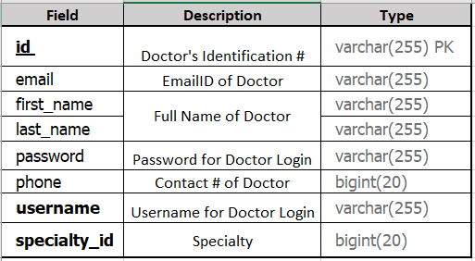
Typical Data Definition(contd.)
Doctor: The Doctor details(name, contact, specialty, username, password, etc.) are stored in this table. The table is used to keep track of the doctor’s information and used to auto-populate the UI after he/she logs in.

Slide 45
Typical Data Definition(contd.)
Feedback: The feedback details are stored in this table (feedback message, feedback date, etc.)
Field | Description | Type
id | Appointment id | BIGINT
feedback | Reported feedback | VARCHAR(255)
mail_send | Owner’s Email | VARCHAR(255)
client_id | Client Identification # | BIGINT
doctor_id | Doctor Identification # | VARCHAR(255)
created_date | Feedback date | DATETIME(6)

Slide 46
Typical Data Definition(contd.)
meeting_date: Video meeting details are stored in this table (meeting url, meeting password, meeting id, etc.)
Field | Description | Type
id | Client’s id | BIGINT
password | Meeting password | VARCHAR(255)
url | Meeting url | VARCHAR(255)
meeting_id | Meeting id | VARCHAR(255)
occupied | whether a time slot is occupied | BIT(1)

Slide 47
Typical Data Definition(contd.)
Specialty: this table store’s the doctor’s specialty
Field | Description | Type
Id | Doctor’s identification # | BIGINT
name | Specialty Name | VARCHAR(255)

Slide 48
19. Inter-Agent communication
Video link web-service : Input parameters
Parameters | Description
<soapenv:Envelope xmlns:soapenv="http://schemas.xmlsoap.org/soap/envelope/" xmlns:eser="http://eservice/"> <soapenv:Header/> <soapenv:Body> <eser:getZoomLink> <arg0> <surname>Client Surname</surname> <username>Client Name</username> </arg0> </eser:getZoomLink> </soapenv:Body> </soapenv:Envelope> | Client information such as username and surname is sent in the request.

Slide 49
Inter-Agent communication(contd.)
Video link web-service : Output parameters
Parameters | Description
Headers :- Content-type text/xml; charset=utf-8 #status# HTTP/1.1 200 OK Date Thu, 09 Dec 2021 22:40:22 GMT Transfer-encoding chunked <S:Envelope xmlns:S="http://schemas.xmlsoap.org/soap/envelope/"> <S:Body> <ns2:getZoomLinkResponse xmlns:ns2="http://eservice/"> <return> <zoomLinkList> <meetingId>424 588 1231</meetingId> <password>Engg696</password> <url>https://ucalgary.zoom.us/j/4245881231</url> </zoomLinkList> </return> </ns2:getZoomLinkResponse> </S:Body> </S:Envelope> | Meeting details such as the meeting id, password and the video link is received.

Slide 50
Inter-Agent communication(contd.)
Twilio Rest-API : Input parameters
Parameters | Description
public static final String ACCOUNT_SID = System.getenv("TWILIO_ACCOUNT_SID"); public static final String AUTH_TOKEN = System.getenv("TWILIO_AUTH_TOKEN"); Twilio.init(ACCOUNT_SID, AUTH_TOKEN); Message message = Message.creator (new com.twilio.type.PhoneNumber("+14159352345"), new com.twilio.type.PhoneNumber("+14158141829"), "Where's Wallace?") .create(); | Account SID and Authentic Token of Twilio account is mentioned in the snippet

Slide 51
Inter-Agent communication(contd.)
Twilio Rest-API : Output parameters
Parameters | Description
{ "account_sid": "ACXXXXXXXXXXXXXXXXXXXXXXXXXXXXXXXX", "api_version": "2010-04-01", "body": "Hi there", "date_created": "Thu, 30 Jul 2015 20:12:31 +0000", "date_sent": "Thu, 30 Jul 2015 20:12:33 +0000", "date_updated": "Thu, 30 Jul 2015 20:12:33 +0000", "direction": "outbound-api", "error_code": null, "error_message": null, "from": "+14155552345", "messaging_service_sid": null, "num_media": "0", "num_segments": "1", "price": null, "price_unit": null, "sid": "SMXXXXXXXXXXXXXXXXXXXXXXXXXXXXXXXX", "status": "sent", "subresource_uris": { "media": "/2010-04-01/Accounts/ACXXXXXXXXXXXXXXXXXXXXXXXXXXXXXXXX/Messages/SMXXXXXXXXXXXXXXXXXXXXXXXXXXXXXXXX/Media.json" }, "to": "+14155552345", "uri": "/2010-04-01/Accounts/ACXXXXXXXXXXXXXXXXXXXXXXXXXXXXXXXX/Messages/SMXXXXXXXXXXXXXXXXXXXXXXXXXXXXXXXX.json"} | Parameters from the output of the message from the twilio message received by the user is described in the snippet.

Slide 52
Inter-Agent communication(contd.)
Appointment ➜ email Agent communication
Parameters | Description
Sample Appointment Object :- Appointment{id=85, client=Client{,FirstName=Anish,LastName=Mukherjeeid=1,phone=5875985499,email=anish09.mail@gmail.com,username=anish123,password=null'}, doctor=Doctor{id=1234567894,First Name=Dr.Sam,Last Name=Wilkins,username=doctorD,phone=1234567883, email=talk2anish@gmail.com,specialty=null’}, dateTime=2021-12-10 09:00:00.0, description='The Dog is ill', notes='', criticality=1, status='Scheduled', email='yes’, sms='null', feedback='null', age='5’, breed='Pomerenian'} | Appointment details such as we book appointment of doctor. Username, Password, phone of doctor.

